Slide 1


E-commerce Customer Behaviour Analysis and Insights​
Jarvin Mutatiina
Supervisor
Imad Abo Dehn
Team Leader - Trainee
Ameen Abass
Trainee
Majd Al-Batran
Trainee
Sakaria Abukar
Trainee

Slide 2

agenda
Introduction
Data Overview
Data Processing with Spark
Analysis & Insights
Orchestration with Airflow
CI/CD Pipeline with GitHub Actions
Challenges & Solutions
Conclusion
Q&A

Slide 3




Introduction
Objective:
Analyze e-commerce customer behavior to derive insights that can improve business decision-making.
Scope:
Data Processing with Spark
Orchestration with Airflow
Deployment with GitHub Actions and GCP.

Slide 4
Data Overview
Dataset Description:
Customer transactions including age, city, items purchased, and total spend.
Columns in this file:​
Customer ID - Integer
Gender – String
Age – Integer
City – String
Membership Type – String
Total Spend – Numeric
Items Purchased – Integer
Average Rating – Numeric
Discount Applied – Boolean
Days Since Last Purchase – Integer
Satisfaction Level – String
Data Source:
Stored in Google Cloud Storage, sourced from Kaggle.
Key Variables:
Discount Applied, Membership Type, Satisfaction Level and Total Spend.

Slide 5
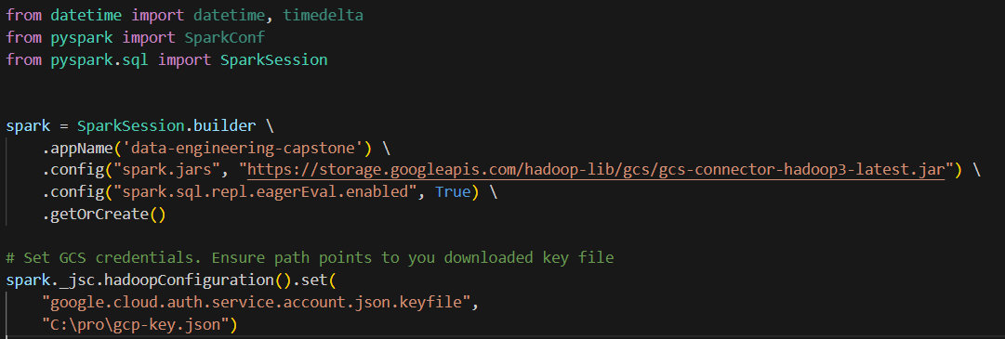
Data Processing with Spark
Spark Setup:
Configuring Spark with GCP connector to read and write data.

Slide 6
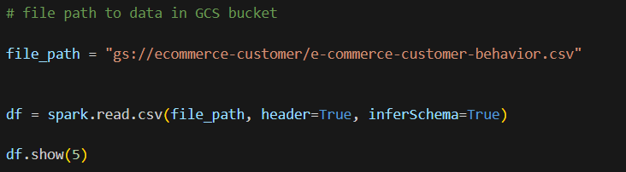
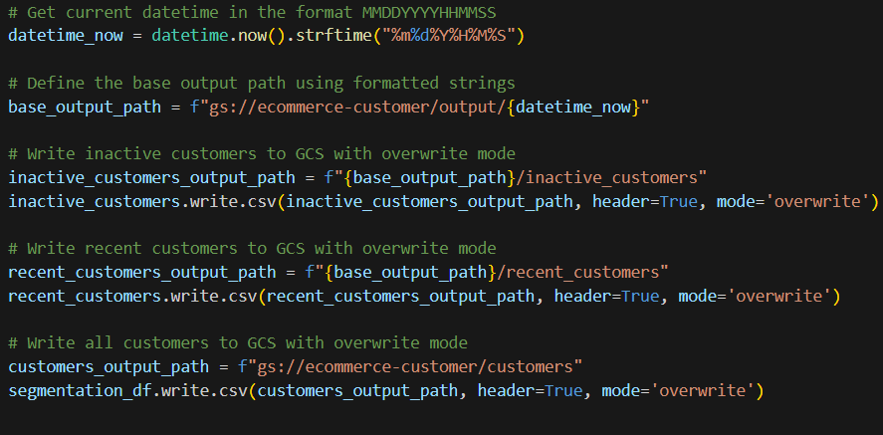
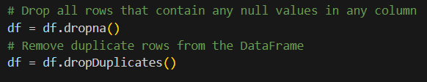
Data Processing with Spark
ETL Pipeline:
1. Extract: Read data from GCP.​
3. Load: Write transformed data back to GCP.​
2. Transform: cleaning the data.​​

Slide 7
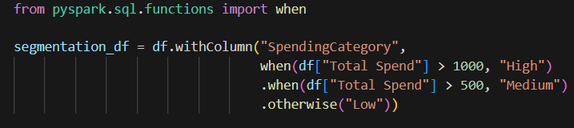
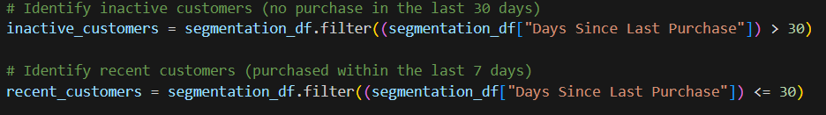
Analysis & Insights
Customer Segmentation:
  Segmenting customers based on spending habits and activity

Slide 8
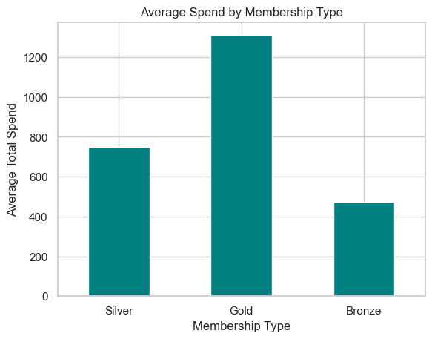
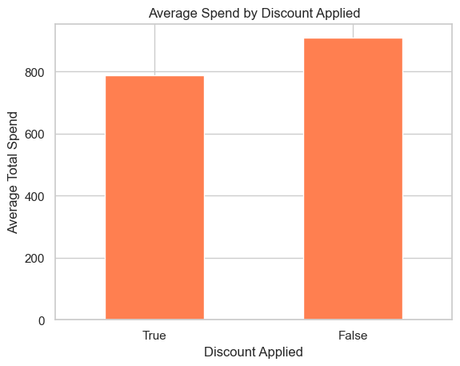
Analysis & Insights
Spending Behaviour Analysis:
Plotting Average Spend by Membership Type
Plotting Average Spend by Discount Applied

Slide 9
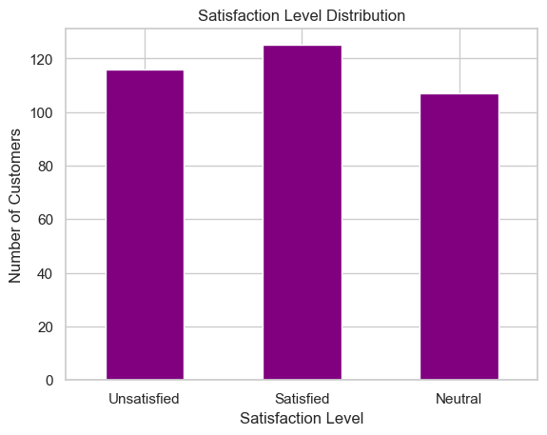
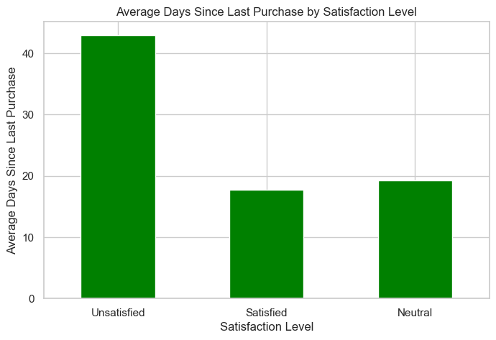
Analysis & Insights
Satisfaction Analysis:
Churn Prediction Indicators:
Satisfaction Level Distribution
Average Days Since Last Purchase by Satisfaction Level

Slide 10
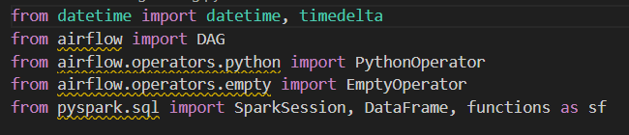
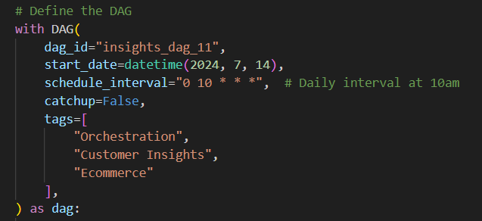
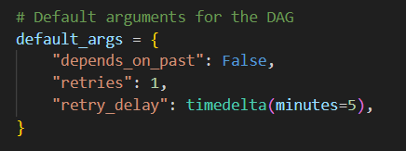
Orchestration with Airflow
DAG Definition Components 1:
1. Library imports:
3. DAG definition:
DAGs are scheduled to run daily at 10 AM.
2. DAG arguments:

Slide 11
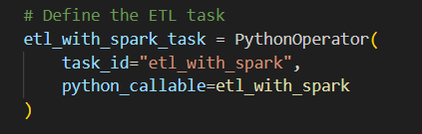


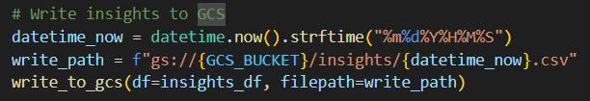

Orchestration with Airflow
DAG Definition Components 2:
3. ETL Task "etl_with_spark()" steps:
4. ETL Task definition:
Configuring Spark:
Extract:
Transform:
Load:
5. Task pipeline:

Slide 12
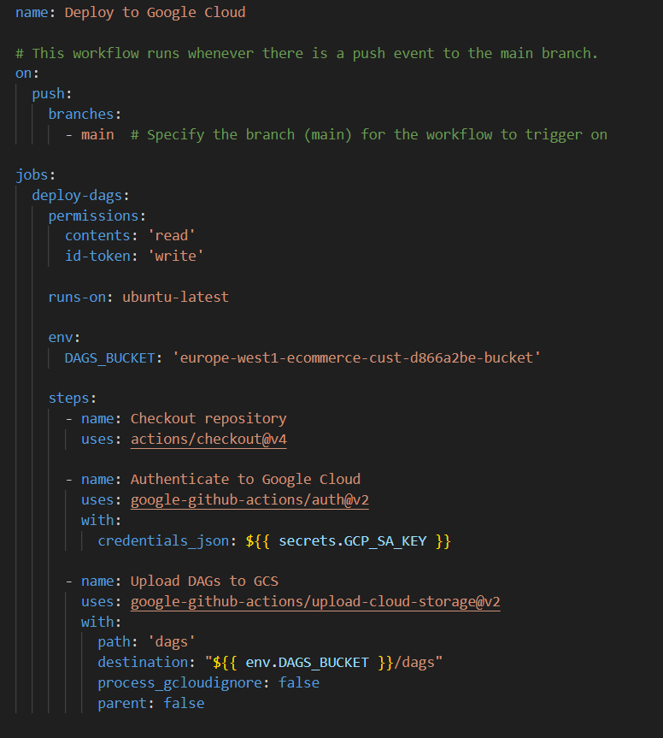
CI/CD Pipeline with GitHub Actions
Workflow Setup:
Configuring GitHub Actions to deploy DAGs to GCP.
Code Snippets:
YAML configuration for GitHub Actions.​

Slide 13
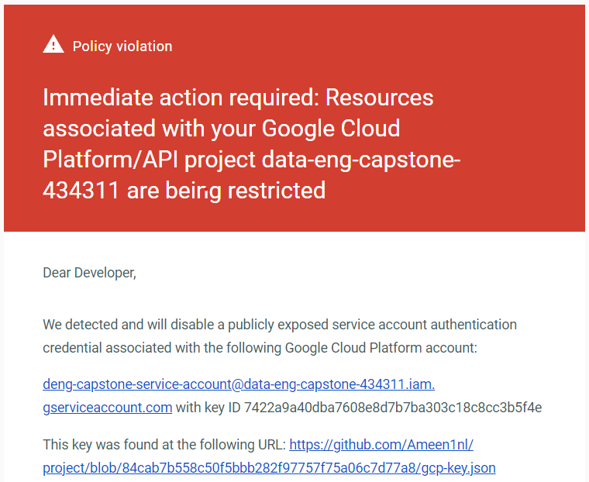
Challenges & Solutions
Deployment:
Overcame issues with CI/CD setup and Airflow deployment.
Overcame issues with Git version control
Security:
Overcame issue with secure handling of GCP credentials.

Slide 14

Conclusion
Summary:
In conclusion, our analysis of customer data has revealed valuable insights into satisfaction levels, spending patterns, and membership behavior.
Recommended actions:
Prioritize customer satisfaction.
Optimize discount strategies.
Enhance membership benefits.
Segment customers.
Notes:
Key findings include:
Satisfaction: While most customers are satisfied, there is a significant group of unsatisfied customers.
Spending: Discounts have a positive impact on spending, and Gold members consistently spend more than Silver or Bronze members.
Loyalty: Unsatisfied customers are more likely to repurchase, suggesting opportunities to improve retention.
Recommended actions:
Prioritize customer satisfaction: Invest in initiatives to address the concerns of unsatisfied customers and improve overall satisfaction.
Optimize discount strategies: Continuously evaluate the effectiveness of discount programs and explore new strategies to maximize customer spending.
Enhance membership benefits: Consider offering additional benefits to Silver and Bronze members to encourage higher spending and improve loyalty.
Segment customers: Use customer data to identify distinct segments and tailor marketing and product offerings to their specific needs.

Slide 15
Q&A
Thank you for
your time and attention
Thank you

